Slide 1
Predicting 30-Day Hospital Readmission for Diabetic Patients
DSC630 - Allyson Totpal
Notes:
Hello, my name is Allyson and for my final project, I built a model to predict 30-day hospital readmission for diabetic patients.

Slide 2
01.
Overview
Notes:
In Section 1, we’ll overview the project scope and why this topic is important.

Slide 3
Background + Motivation
Hospital readmissions within a short timeframe poses significant clinical and financial challenges for hospitals, and chronic illness patients are especially vulnerable to complications that leads to re-hospitalization. Readmission is 17% more likely among diabetic patients.
Notes:
Hospital readmissions pose both clinical and financial challenges, with chronic illness patients especially vulnerable to complications that lead to re-hospitalization. Amongst diabetic patients, readmission is 17% more likely to occur this project aims to identify these high-risk patterns (Enomoto, Gabbay, Hollenbeak, Rosenthal, & Shrestha, 2021). Identifying these high-risk patients can assist in targeted interventions, optimization of care coordination, and reduction of costs to improve conditions for both the hospital and patient side.
Enomoto, L., Gabbay, R., Hollenbeak, C. Rosenthal, M., & Shrestha, D. (2021). Risk factors associated with 30-day readmission and length of stay in patients with type 2 diabetes. PubMed. https://pubmed.ncbi.nlm.nih.gov/27838101/

Slide 4
Research Questions
Question 1
What comorbidities, if any, are most predictive of hospital readmission? Are the common comorbidities (hypertension & CKD) likely to raise the likelihood?
Question 2
Which models provide both predictive accuracy and interpretability for the data being handled?
Notes:
Two significant research questions were highlighted at the start of this project:

Slide 5
02.
Data & Preprocessing
Notes:
Now let’s go over the data and preprocessing steps taken to build a good foundation for the models.

Slide 6
Dataset Overview
Source: UCI Diabetes 130-US hospitals dataset
Scope: Over 100,000 inpatient records
Target Variable: 30-day hospital readmission (readmit_30)
Features: Demographics, diagnoses (ICD-9), procedures, medications, etc.
Comorbidities Tagged: Hypertension and Chronic Kidney Disney identified via diagnosis codes
Notes:
For this project, I utilized the UCI Diabetes 130-US hospital dataset, which covers over 100,000 inpatient records between the years 1999-2008. Features included demographics, diagnoses using ICD-9 codes, procedures, medications, and more. Amongst this dataset though, our target variable was 30-day hospital readmission. My original project scope was focusing on the two prevalent comorbidities, hypertension and Chronic Kidney Disease (CKD), and identified those via diagnosis codes to see if they had any significant influence on readmission likelihood.

Slide 7
Data Filtering & Preparation
Used top 30% of encounter IDs as proxy for latest 3 years (2005-2008)
Downsampled to 10,000 encounters for performance
Removed high-missing fields & identifiers
Flagged comorbidities (HTN, CKD) using ICD-9 patterns
One-hot encoding for categorical variables
Notes:
To filter and prepare the data, I used the top 30% of encounter IDs as a proxy for the latest 3 years of the data, 2005 to 2008. I then further downsampled the 30% to 10,000 encounters as to provide efficient performance when running the models. I also removed high-missing fields and identifiers, flagged comorbidities as mentioned in the previous slide), and one-hot encoded for categorical variables to factors.

Slide 8
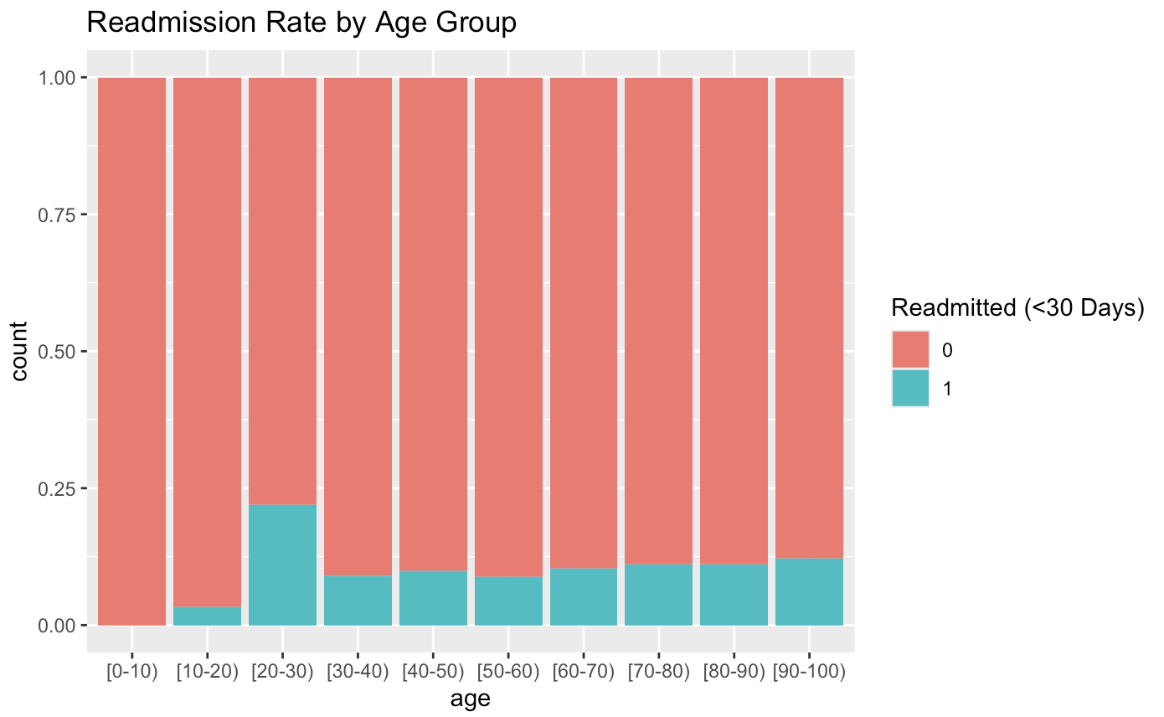
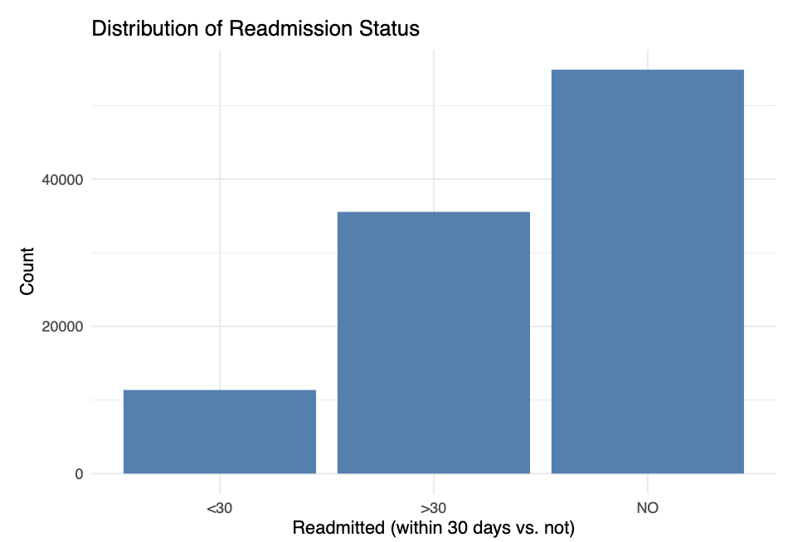
Exploratory Data Analysis (EDA)
Notes:
Starting with our exploratory data analysis, or EDA, we explored readmission rate by age group, which provided a surprising insight showcasing that age group 20-30 years old had the highest percentage of readmission within 30 days vs other age groups. As we’ll highlight later in the next slide, the distribution of readmission status was highly imbalanced, showing that readmissions within 30 days were not even half of the cases of over 30 day readmission and non-readmissions.

Slide 9
Handling Class Imbalance
Observation
Data Split
There are more no readmission encounters than there are readmission
Ensured post-balancing data split
SMOTE
Balanced Dataset
Duplicated positive cases and interpolates between neighbors
Improved model sensitivity
Notes:
An observation made was that there were more non-readmission encounters than there were readmissions, which created a large class imbalance. I applied SMOTE, synthetic minority over-sampling technique, to duplicate positive cases and interpolate between neighbors, while also ensuring a post-balancing data split of 70/30. The balanced dataset helped improve model sensitivity, which enables better detection of patients likely to be readmitted.

Slide 10
03.
Modeling & Results
Notes:
Now that our dataset has a strong foundation, it was time to move into model building and seeing results.

Slide 11
Models & Metrics
Models Used:
Logistic Regression (baseline)
Random Forest
XGBoost
Evaluations Used:
AUC (ROC)
Confusion Matrix
Accuracy, Sensitivity, Precision, & Recall
F-1 Score
Notes:
The three models built in this project were Logistic Regression to establish a baseline, and then Random Forest and XGBoost. Evaluations used were AUC(ROC), confusion matrix to address accuracy, sensitivity, precision, recall, and F-1 score.

Slide 12
Model Performances
 | LR | RF | XG
AUC | 0.774 | 0.926 | 0.865
Accuracy | 76.1% | 89.9% | 90.5%
Recall | 38.7% | 61.2% | 64.5%
Precision | 56% | 100% | 98.8%
F1-Score | 0.458 | 0.759 | 0.780
Balanced Acc. | 63.9% | 80.6% | 82.1%
Interpretation | Struggled to identify true positives | High precision, strong overall performance, but some recall trade-off | Best balance of precision and recall overall
Notes:
Here are how the models performed. Logistic regression estimates readmission risk using a simple mathematical formula and correctly predicted about 76% of patient outcomes. However, it missed more than half of the actual readmissions and was better at identifying who would not be readmitted than who would. It provided an overall good baseline but did not perform well enough for real-world decision-making. Random Forest models use hundreds of decision trees to make a smarter prediction and it correctly predicted about 90% of all patient outcomes. It caught over 60% of the patients who were readmitted and when it predicted someone would be readmitted, it was always right in this test. This shows that the model was extremely confident and a strong model with high precision, but with a low recall, it only caught about 61% of actual admissions, missing about 39% of true cases. While extremely precise, its lower recall means it failed to identify many patients who were actually readmitted and in clinical settings, missing at-risk patients is a serious concern that is trying to be addressed with this project. XGBoost is the most advanced model out of the three as it learns from its mistakes. It predicted about 90% of patient outcomes correctly, and caught slightly more true readmissions than Random Forest while maintaining very high precision. XGBoost provided the best balance as it was accurate, careful, and more inclusive of true positives and makes it the most reliable model in this analysis for identifying patients at risk.

Slide 13
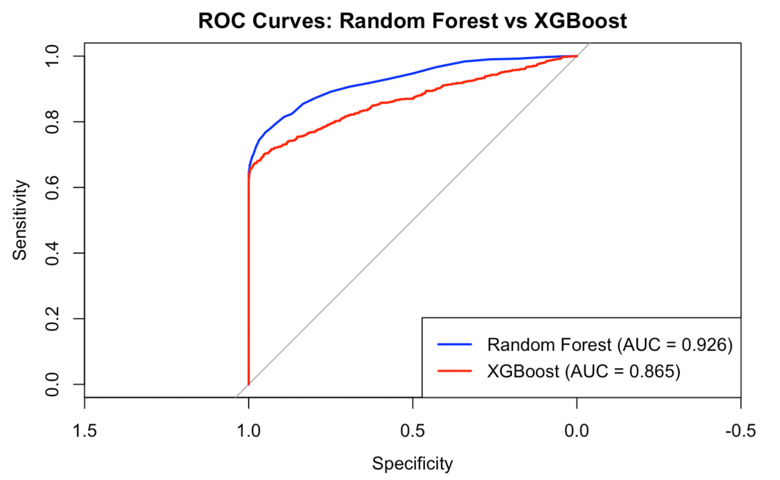
ROC Curves
Notes:
Because Logistic Regression was only to provide a baseline, the ROC Curves shown are for Random Forest and XGBoost. A ROC curve helps to visualize how good a model is at spotting future readmissions, and the higher the curve means better performance. Random Forest had the strongest curve, meaning it was confident at separating at risk patients from those not likely to return. XGBoost had a slightly more balanced curve, it was nearly as good and more inclusive in catching true admissions. The takeaway is that advanced models like Random Forest and XGBoost are effective at recognizing patterns that signal hospital readmission, with Random Forest performing slightly better overall in this test.

Slide 14
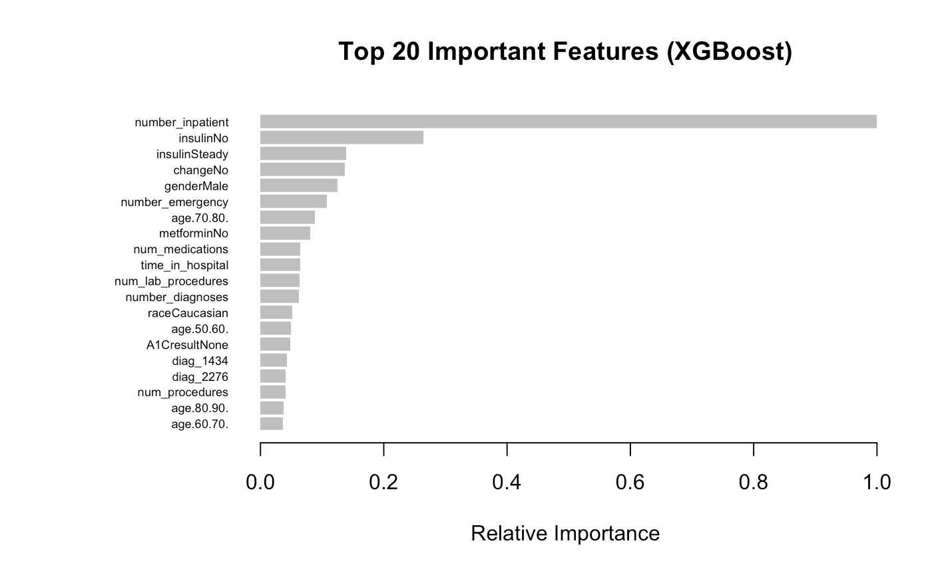
Feature Importance
Notes:
Feature importance allows us to highlight the top features the XGBoost model relied on most to make its predictions. The top factor was how many times a patient had been hospitalized before, meaning more past admissions meant higher risk. Insulin usage and whether their medications changed or stayed steady were also big indicators. Emergency visits and longer hospital stays also raised some concerns, and interestingly, age and gender played some role, but not as strong. The original scope of the project was including comorbidities hypertension and CKD into the mix and seeing how influential they were in hospital readmissions, but they did not show up in the top 20, indicating there are stronger factors at play. Feature importance observations show that the model learned that patient care patterns, not just diagnoses, are key to predicting who’s likely to be readmitted.

Slide 15
04.
Conclusions
Notes:
Now onto final limitations and conclusions of this project.

Slide 16
Limitations
1. Outdated dataset
2. Diagnosis codes may be noisy and are outdated (ICD-9 vs ICD-10)
3. Medication adherence and outpatient data missing
4. No validation on external datasets
5. SMOTE may introduce synthetic bias
Notes:
Limitations of this project and data are important to highlight. The UCI Diabetes dataset was the most easily accessible data without needing prior clearance and monetary contributions to access more recent data. The UCI Diabetes dataset contains records obtained from 1999-2008. While valuable for academic modeling, it may not accurately reflect current clinical practices, medication standards, or demographic trends and thus will limit generalizability of findings to today’s environment. However, it can provide a foundation to scale to today’s environment with more current data. The diagnosis codes were also outdated, using the previous ICD-9 codes over the current ICD-10. Medication adherence and outpatient data are missing, which could provide key insight into other factors that may attribute to readmissions. There was also no validation on external datasets as diabetic-focused datasets are not easily accessible, and SMOTE may introduce synthetic bias. These limitations are something to consider moving forward after this project.

Slide 17
Key Takeaways
Ensemble models outperformed Logistic Regression
XGBoost offers best balance of recall and precision
Feature importance reveals indirect indicators
Class balancing was critical to detect real patterns related to minority class (readmitted_30)
Notes:
Some key takeaways are that the ensemble models, Random Forest and XGBoost, outperformed our baseline model, Logistic Regression. XGBoost offered the best balance of recall and precision, and the feature importance revealed indirect indicators that attributed to hospital readmissions. Class balancing was also important in detecting real patterns related to the readmission within 30 days target. Overall, this final project on predicting predicting hospital readmissions within 30-days amongst diabetic patients provided great experience with applying these models and a step towards creating better patient care experiences.

Slide 18
References
Cios, K., Clore, J., DeShazo, J., Gennings, C., Olmo, J., Strack, B., Ventura, S. (2014). “Impact of HbA1c Measurement on Hospital Readmission Rates: Analysis of 70,000 Clinical Database Patient Records,” BioMed Research International, vol. 2014, Article ID 781670, 11 pages, 2014. https://archive.ics.uci.edu/dataset/296/diabetes+130-us+hospitals+for+years+1999-2008
Enomoto, L., Gabbay, R., Hollenbeak, C. Rosenthal, M., & Shrestha, D. (2021). Risk factors associated with 30-day readmission and length of stay in patients with type 2 diabetes. PubMed. https://pubmed.ncbi.nlm.nih.gov/27838101/

